Slide 1
PIPE(PHY Interface for the PCI Express)
V.SRAVANTHI
CHIPWEAVE TECHNOLOGIES PVT LMD

Slide 2
CONTENTS
INTRODUCTION
FEATURES
ARCHITECTURE
INTERFACE SIGNAL DESCRIPTION
MAC REGISTERS
PHY REGISTERS
PIPE Operational Behaviour

Slide 3
Introduction
PIPE stands for PHY Interface for PCI Express.
PCIe Stands for Peripheral Component Interconnect Express.
PCIe Physical Layer
The PCIe PHY layer handles the low level PCIe protocol and signaling.
It defines a standard interface between a PHY and a Media Access Layer (MAC) and a Link Layer ASIC

Slide 4
Features of PCIe PHY Layer
The standard PHY interface enables multiple IP sources for the PCIe logical layer and provides a target interface for PCIe PHY vendors.
Support for 2.5 GT/s ,5.0 GT/s, 8.0 GT/ s and 16 GT/s and 32 GT/s, 64 GT/s and 128 GT/s serial data transmission rate.
Utilizes of 8-bit, 16-bit, or 32-bit parallel interfaces to transmit and receive PCIe data. Additionally, it supports a 64-bit interface (in SerDes architecture only).
Allowed integration of high-speed components into a single functional block as seen by the endpoint device designer.

Slide 5
Features of PCIe PHY Layer
8b/10b encoding and decoding, and error indication.
128b/130b encoding and decoding, and error indication.
Receiver detection.
Beacon transmission and reception.
Data and clock recovery from serial stream on the PCIe bus

Slide 6
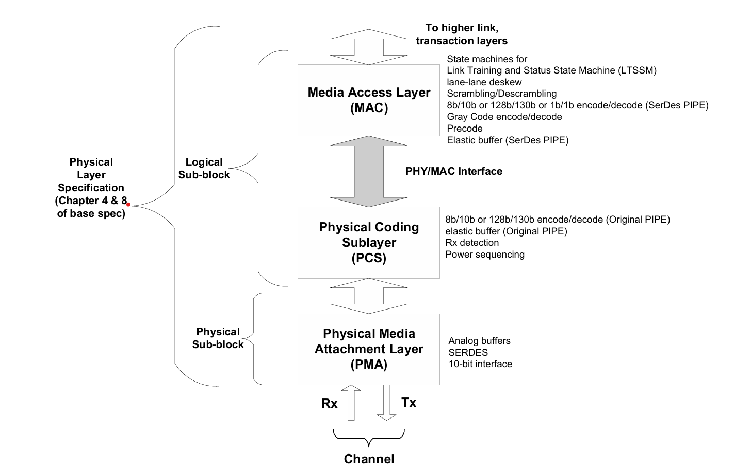
Partitioning PHY layer for PCIe

Slide 7
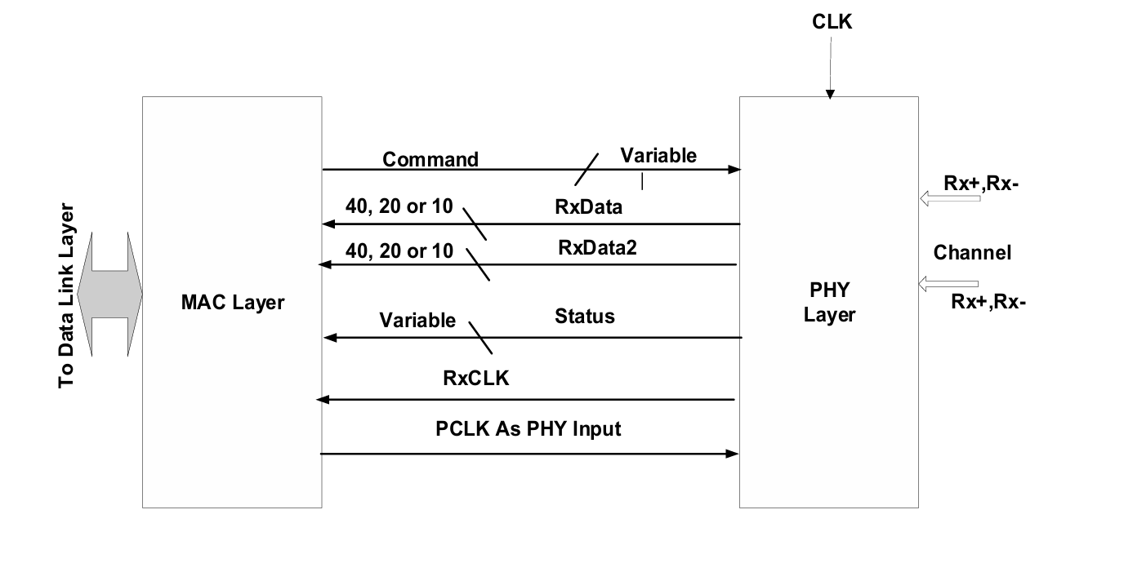
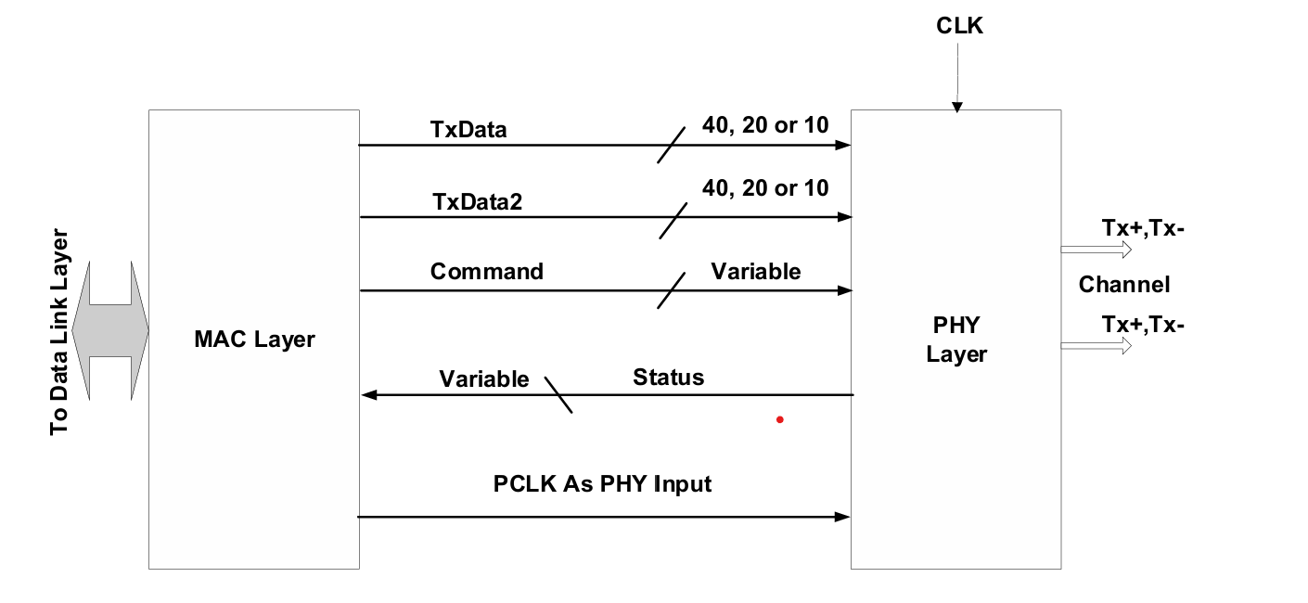
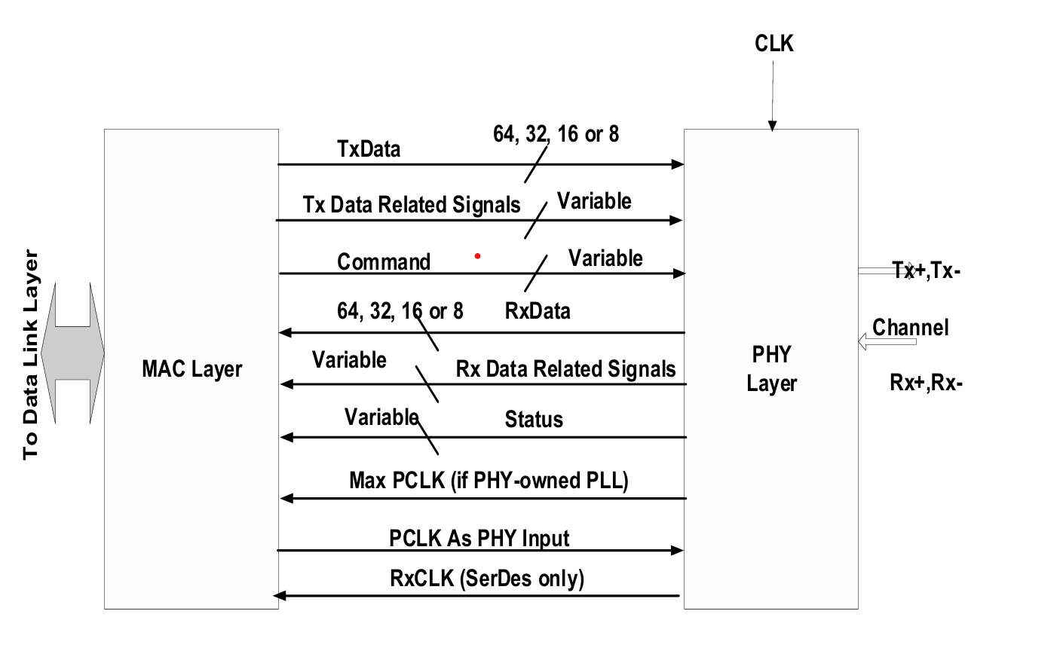
PHY/MAC Interface
Fig1:DPRX PHY/MAC Interface Fig2:DPTX PHY/MAC Interface

Slide 8
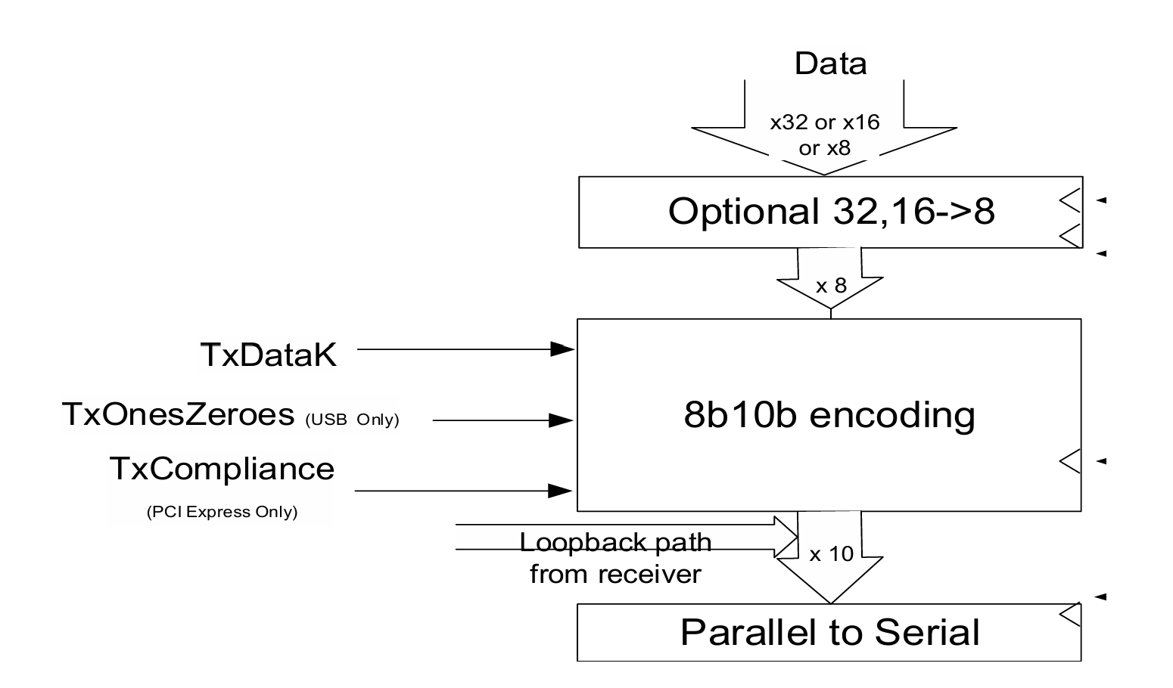
PIPE Architecture
Transmitter Block Diagram

Slide 9
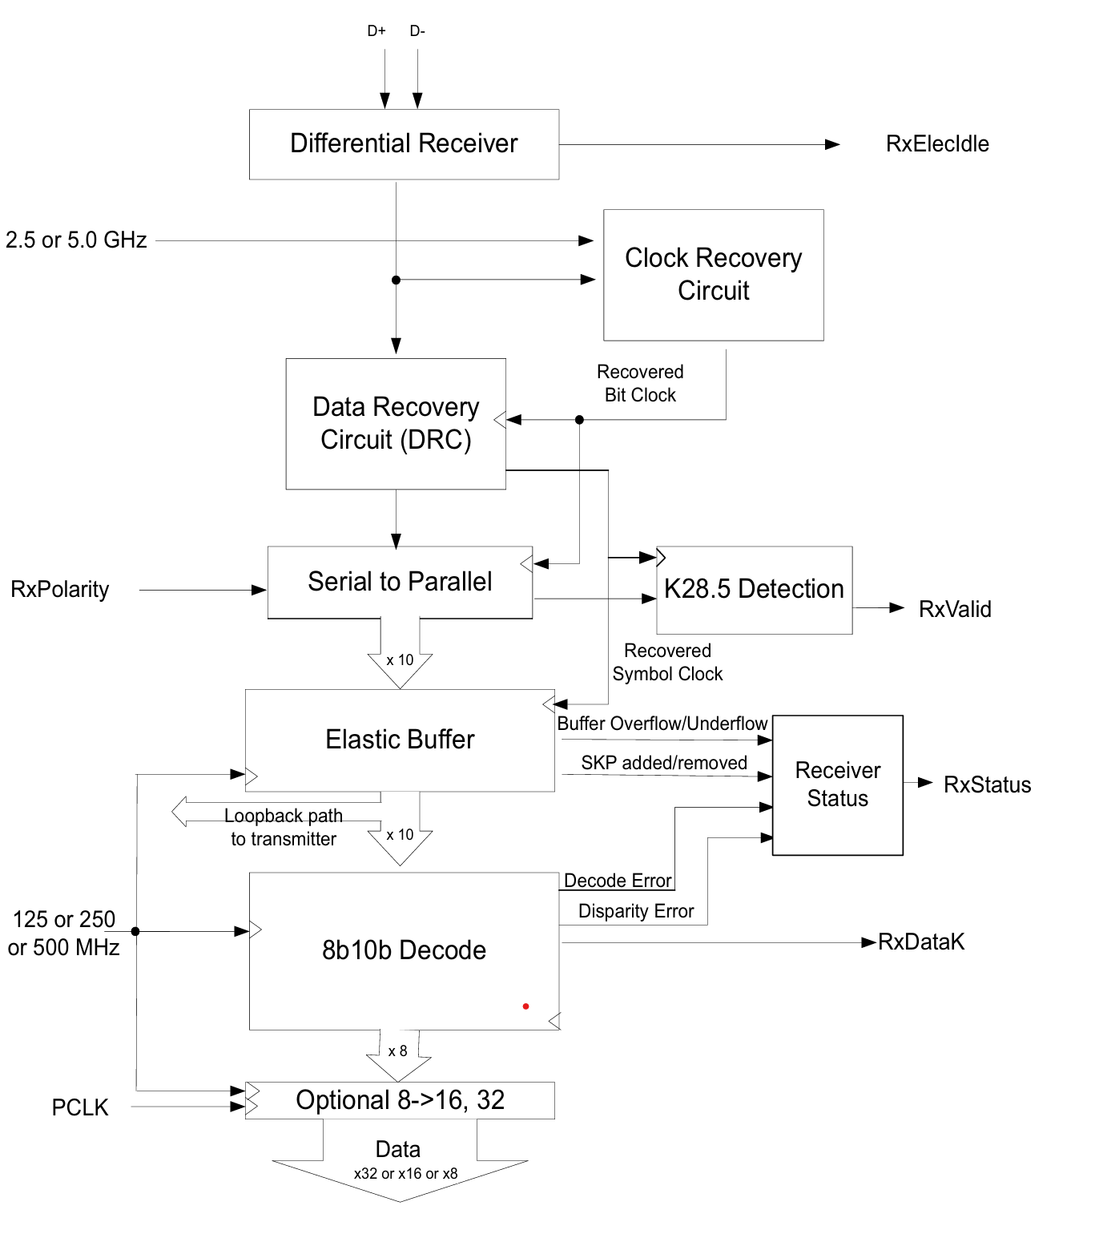
Receiver Block Diagram

Slide 10
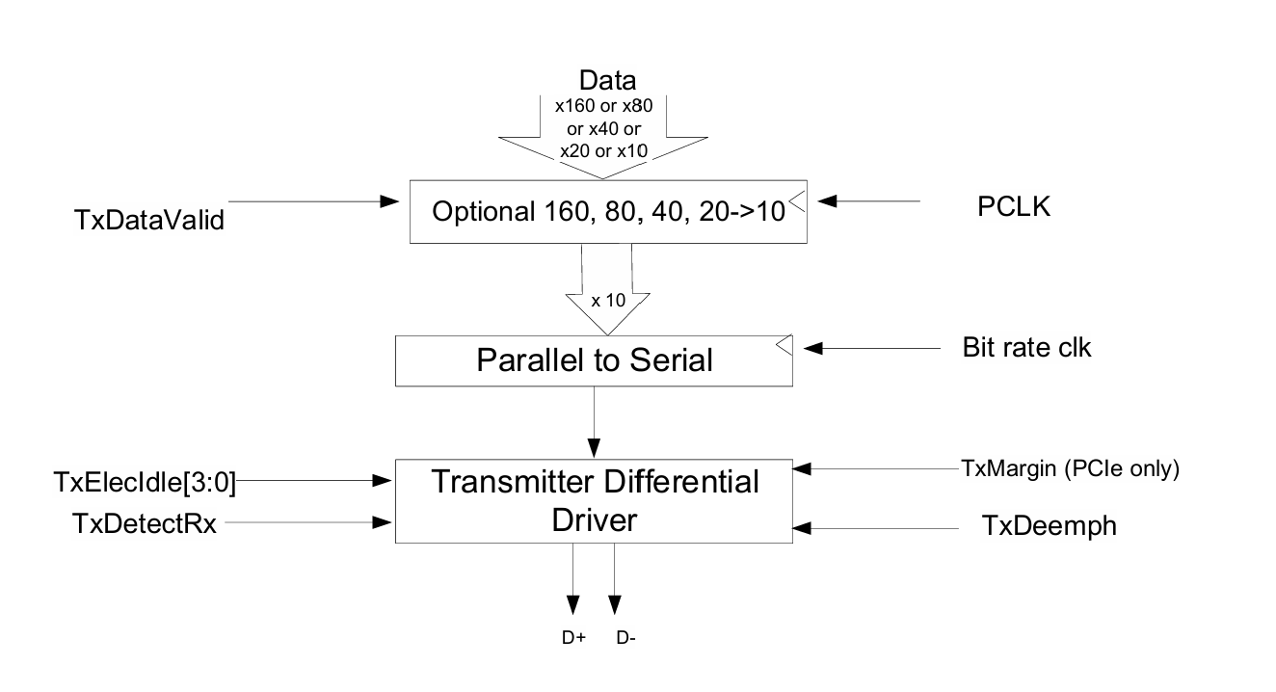
SerDes Architecture
With the SerDes architecture, the PHY implements minimal digital logic compared to the original PIPE architecture.

Slide 11
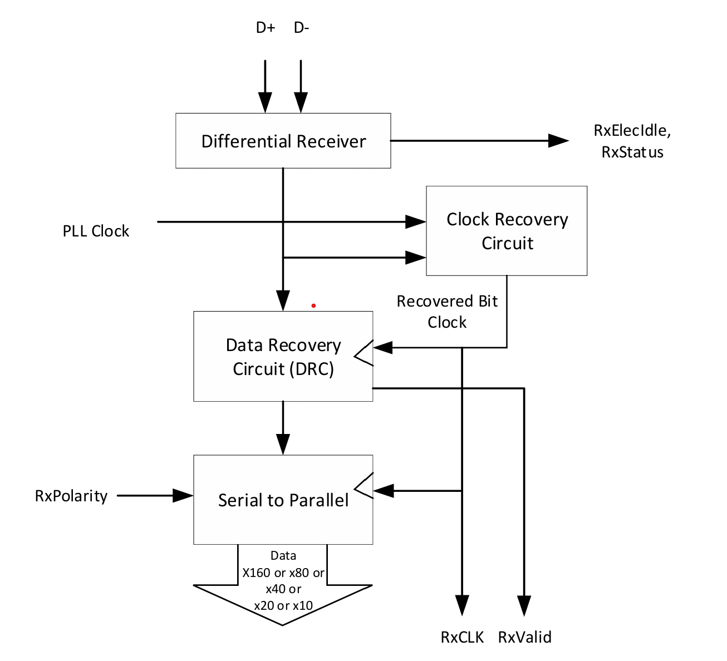
PHY Receiver Block Diagram

Slide 12
PIPE Interface Signal Descriptions​
Tx Data Interface Input Signals ​
​ Signal​ | ​ Description​
Tx Data[31:0] for 32-bit interface​ | 32 bits represent the 4 symbols of Tx data. ​ Tx Data[7:0] → 1st symbol​ Tx Data[15:8] → 2nd symbol​ Tx Data[23:16] → 3rd symbol​ Tx Data[31:24] → 4th symbol​ ​
Tx Data[15:0] for 16-bit interface​ | 16 bits represent the 2 symbols of Tx data. ​ Tx Data[7:0] → first symbol​ Tx Data[15:8] → second symbol​ ​
Tx Data[7:0] for 8-bit interface​ | 8 bits represent the 1 symbols of Tx data. ​ ​

Slide 13
Tx Data Interface Input Signals ​
​ Signal(SerDes)​ | ​ Description​
Tx Data[159:0] for 160-bit interface​ | ​ 160-bit interface, 160 bits represent 16 symbols of Tx data​
Tx Data[79:0] for 80-bit interface​ | For the 80-bit interface, 80 bits represent eight symbols of Tx data​
Tx Data[39:0] for 40-bit interface​ | For the 40-bit interface, 40 bits represent Four symbols of Tx data​ ​
Tx Data[19:0] for 20-bit interface​ | For the 20-bit interface, 20 bits represent Two symbols of Tx data​
Tx Data[9:0] for 10-bit interface​ | For the 10-bit interface, 10 bits represent One symbols of Tx data​
Tx+, Tx -​ | Tx+/Tx- are differential signal pairs used by the PHY to transmit high-speed serial on a PCIe lane.​

Slide 14
Rx Data Interface Input Signals
Rx Data Interface Input Signals​
Signal | Direction
Rx+, Rx -​ | Rx+/Rx- are differential signal pairs used by the PHY to receive high-speed data on a PCIe lane.​
Rx Data Interface Output Signals ​
​ Signal​ | ​ Description​
Rx Data[31:0] for 32-bit interface​ | 32 bits represent the 4 symbols of Rx data. ​ Rx Data[7:0] → 1st symbol​ Rx Data[15:8] → 2nd symbol​ Rx Data[23:16] → 3rd symbol​ Rx Data[31:24] → 4th symbol​ ​
Rx Data[15:0] for 16-bit interface​ | 16 bits represent the 2 symbols of Rx data. ​ Rx Data[7:0] → first symbol​ Rx Data[15:8] → second symbol​ ​
Rx Data[7:0] for 8-bit interface​ | 8 bits represent the 1 symbols of Rx data. ​ ​

Slide 15
Rx Data Interface Output Signals ​
​ Signal(SerDes)​ | ​ Description​
Rx Data[159:0] for 160-bit interface​ | ​ 160-bit interface, 160 bits represent 16 symbols of Rx data​
Rx Data[79:0] for 80-bit interface​ | For the 80-bit interface, 80 bits represent eight symbols of Rx data​
Rx Data[39:0] for 40-bit interface​ | For the 40-bit interface, 40 bits represent Four symbols of Rx data​ ​
Rx Data[19:0] for 20-bit interface​ | For the 20-bit interface, 20 bits represent Two symbols of Rx data​
Rx Data[9:0] for 10-bit interface​ | For the 10-bit interface, 10 bits represent One symbols of Rx data​

Slide 16
Command Interface Input Signals​
​ Signal​ | ​ Description​
PHY mode[3:0]​ | Selects the PHY operating mode​
PHY_mode​ | Meaning​
0​ | PCIe​
1​ | USB​
2​ | SATA​
3​ | DisplayPort​
7​ | USB4​
Others​ | Reserved​

Slide 17
Command Interface Input Signals​
​ Signal​ | ​ Description​
​ SRISEnable ​ | ​ SRISEnable tells the PHY to operate in SRIS mode, where transmitter and receiver use independent reference clocks.​
TxDetectRx/ Loopback​ | TxDetectRx/Loopback tells the PHY to perform receiver detection, loopback, or USB LFPS signaling depending on protocol and state.​
​ TxElecIdle[3:0]​ | TxElecIdle forces the PHY transmitter into electrical idle and is qualified by TxDataValid, with symbol-level control in PCIe SerDes modes.​
Reset#​ ​ | Reset# is an asynchronous active-low signal that resets the PHY TX/RX and forces the PHY into its lowest power state​

Slide 18
Command Interface Input Signals
​ Signal​ | ​ Description​
​ PowerDown[3:0]​ | ​ PowerDown[3:0] is a PIPE command bus used by the MAC to control PHY power states​ [3] [2] [1] [0] Description​ 0 0 0 0 P0 – Normal operation​ 0 0 0 1 P0s – Low recovery time latency, power saving state​ 0 0 1 0 P1 – Longer recovery time latency, lower power state​ 0 0 1 1 P2 – Lowest power state​ 0 1 0 0 POWER_STATE_4 – PHY-specific​ 0 1 0 1 POWER_STATE_5 – PHY-specific​ 0 1 1 0 POWER_STATE_6 – PHY-specific​ 0 1 1 1 POWER_STATE_7 – PHY-specific​ 1 0 0 0 POWER_STATE_8 – PHY-specific​ 1 0 0 1 POWER_STATE_9 – PHY-specific​ 1 0 1 0 POWER_STATE_10 – PHY-specific​ 1 0 1 1 POWER_STATE_11 – PHY-specific​ 1 1 0 0 POWER_STATE_12 – PHY-specific​ 1 1 0 1 POWER_STATE_13 – PHY-specific​ 1 1 1 0 POWER_STATE_14 – PHY-specific​ 1 1 1 1 POWER_STATE_15 – PHY-specific​

Slide 19
Command Interface Input Signals
​ Signal​ | ​ Description​
​ ShortChannelPowerControl[1:0]​ | ​ This signal is optionally supported by the PHYs to enable multi-chip package solutions that can be optimized for power due to a shorter channel reach. This signal must be stable before Reset# is deasserted and cannot change value until the next Reset# assertion.​ PowerControlSetting0 (00b): Normal operation​ ​ PowerControlSetting1 (01b): The most aggressive power-optimized setting​ for MCP (required if the ShortChannelPowerControl[1:0]​ signal is implemented)​ ​ PowerControlSetting2 (10b): Optionally supported​ ​ PowerControlSetting3 (11b): Optionally supported​

Slide 20
Command Interface Input Signals
​ Signal​ | ​ Description​
​ RxEIDetectDisable​ | ​ RxEIDetectDisable allows the MAC to asynchronously disable the PHY’s receiver electrical-idle detection and force RxElecIdle high, simplifying PCIe L1 substate power management.​
TxCommonmode Disable​ | Optionally implemented by the PHY to facilitate the L1 substate management. When asserted, this signal asynchronously disables the transmitter DC common mode logic.​
​ DeepPMReq#​ | DeepPMReq# is an active-low asynchronous request from MAC to PHY allowing or disallowing entry into deep power-management states in non-P0 modes, with a required handshake using DeepPMAck#.​ DeepPMReq# = 0 → Request deep power management​ DeepPMReq# = 1 → Do not allow deep power management​

Slide 21
Command Interface Input Signals
​ Signal​ | ​ Description​
​ PCLK Rate[4:0]​ | Control the PIPE PCLK rate​ Value PCIe Mode Frequency​ 0 62.5 MHz​ 1 125 MHz​ 2 250 MHz​ 3 500 MHz​ 4 1000 MHz​ 5 2000 MHz​ 6 4000 MHz​ All others Reserved​
RxStandby​ | Controls whether the PHY RX is active when the PHY is in P0 or P0s.​ 0 – Active​ 1 – Standby ​
​ RefClkRequired#​ | This signal is deasserted by the PHY when the reference clock can be safely removed in low power states.​
RxStandbyStatus​ | RxStandbyStatus is a PHY output that indicates whether the high-speed receiver is active or in standby, mainly used for power-state awareness in PCIe,​ 0 – Active​ 1 – Standby ​

Slide 22
Status Interface Input Signals
​ Signal​ | ​ Description​
​ PclkChangeAck​ | Only used when PCLK is a PHY input. Asserted by the MAC when a PCLK rate change or rate change or, if required, width change is complete and stable.​
AsyncPowerChangeAck​ | Only used when transitioning between two power states without PCLK.​
RxValid​ | Indicates symbol lock and valid data on RxData and RxDataK and further qualifies RxDataValid when used.​
PhyStatus​ | Used to communicate the completion of several PHY functions including stable PCLK and Max PCLK (depending on the clocking mode) after Reset# deassertion, power management state transitions, rate change, and receiver detection​
​ RxElecIdle​ | Indicates receiver detection of an electrical idle. While deasserted with the PHY in P2 (PCIe mode) or the PHY in P0, P1, P2, or P3 (USB mode and USB4 mode), indicates detection of either​
PclkChangeOk​ | PclkChangeOk is a handshake signal from PHY telling the MAC that it is safe to change the PCLK frequency, link rate, or interface width.​
DeepPMAck# ​ | Deep Power Management Ack. This is an asynchronous signal used to acknowledge transitions on DeepPMReq#. This signal is only required on a PHY that implements DeepPMReq#.​

Slide 23
Message Bus Interface ​
The message bus interface is a simple, clocked control channel between MAC and PHY that allows slow configuration and status operations using register reads and writes, without adding new wires, and works only when PCLK is running​
Bus​ | Direction​ | Purpose​
M2P_MessageBus​ | MAC → PHY​ | The MAC multiplexes command, any required address, and any required data for sending read and write requests to access the PHY PIPE registers and for sending read completion responses and write ack responses to PHY initiated requests.​
P2M_MessageBus​ | PHY → MAC​ | The PHY multiplexes command, any required address, and any required data for sending read and write requests to access MAC PIPE registers and for sending read completion responses and write ack responses to MAC initiated requests.​

Slide 24
Message Bus Interface Commands ​
The 4-bit commands used for accessing the PIPE registers across the message bus​
Encoding​ | Command​ | Description​ | Required Fields​ | Cycles to Transmit​
4’b0000​ | NOP​ | Indicates idle on the message bus​ No operation is performed​ | Command[3:0]​ | 1​
4’b0001​ | write_uncommitted​ | Stores the write into a temporary write buffer​ Register value is NOT updated immediately​ | Command[3:0], Address[11:0], Data[7:0]​ | 3​
4’b0010​ | write_committed​ | The current write​ All previously buffered write_uncommitted writes.​ | Command[3:0], Address[11:0], Data[7:0]​ | 3​
4’b0011​ | read​ | Requests to read a PIPE register​ Uses the provided register address​ | Command[3:0], Address[11:0]​ | 2​
4’b0100​ | read_completion​ | Data response to a read. ​ | Command[3:0], Data[7:0]​ | 2​
4’b0101​ | write_ack​ | Acknowledges receipt of write_committed​ | Command[3:0]​ | 1​
All others​ | Reserved​ | N/A​ | N/A​ | N/A​

Slide 25
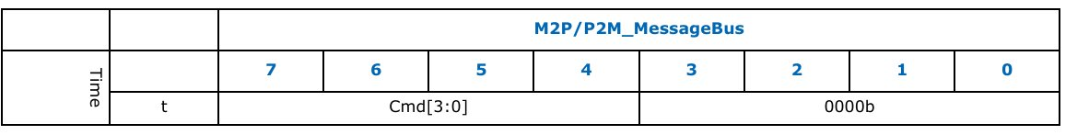
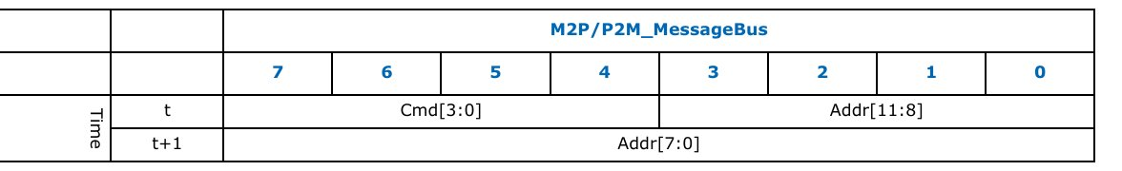
Message Bus Interface
Command Only Message Bus Transaction Timing (NOP, write_ack)
Command Only Message Bus Transaction Timing (Read)​

Slide 26
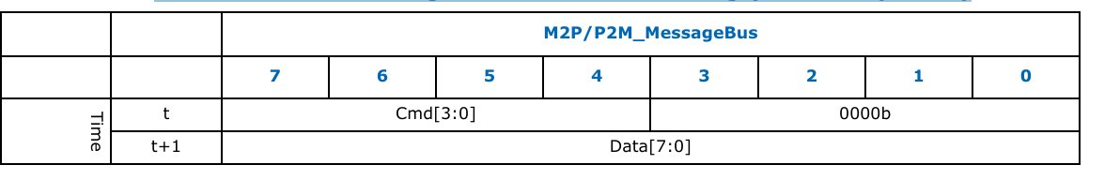
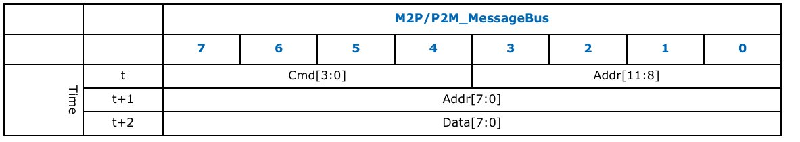
Message Bus Interface
Command+Data Message Bus Transaction Timing (Read Completion)​
Command+Address+Data Message Bus Transaction Timing(Write_uncommitted, Write_committed)​

Slide 27
MAC Registers
Mac registers are used to configure, control, and monitor the MAC layer of a communication interface.
These registers are grouped into 4 logical blocks.
1)Rx Margin Status – Signal quality / eye margin
2)Elastic Buffer – Clock compensation (SerDes-related)
3)Rx Status / Control – Link, error, and control info
4)Link Evaluation Status – Link quality monitoring

Slide 28
MAC Registers
Address space | Register Name
12’h0 | RX1: Rx Margin Status0
12’h1 | RX1: Rx Margin Status1
12’h2 | RX1: Rx Margin Status2
12’h3 | RX1: Elastic Buffer Status
12’h4 | RX1: Elastic Buffer Location
12’h5 | RX1: Rx Status0
12’h6 | RX1: Rx Control0
12’h7 | RX1: Rx Margin Status3
12’h8 – 12’h9 | RX1: Reserved
12’hA | RX1: Rx Link Evaluation Status0
12’hB | RX1: Rx Link Evaluation Status1
12’hC | RX1: Rx Status4
12’hD | RX1: Rx Status5
12’hE | RX1: Rx Link Evaluation Status2
12’hF | RX1: Rx Link Evaluation Status3

Slide 29
MAC Registers
Byte address | Register Name
12’h400 | TX1: Tx Status0
12’h401 | TX1: Tx Status1
12’h402 | TX1: Tx Status2
12’h403 | TX1: Tx Status3
12’h404 | TX1: Tx Status4
12’h405 | TX1: Tx Status5
12’h406 | TX1: Tx Status6
12’h407 | TX1: Tx Status7
12’h408 | TX1: Tx Status8
12’h409 | TX1: Tx Status9
12’h40A | TX1: Tx Status10
12’h40B | TX1: Tx Status11

Slide 30
PHY Registers
Byte Address | Register Name
12’h0 | RX1: Rx Margin Control0
12’h1 | RX1: Rx Margin Control1
12’h2 | RX1: Elastic buffer control
12’h3 | RX1: PHY Rx Control0
12’h4 | RX1: PHY Rx Control1
12’h5 | RX1: PHY Rx Control2
12’h6 | RX1: PHY Rx Control3
12’h7 | RX1: Elastic buffer location update frequency
12’h8 | RX1: PHY Rx Control4
12’h9 | RX1: PHY Rx Control5
12’h10 – 12’hFF | RX1: Reserved
12’h200 – 12’h3FF | RX2: Same registers as RX1

Slide 31
PHY Registers
Byte Address | Register name
12’h400 | TX1: PHY Tx Control 0
12’h401 | TX1: PHY Tx Control 1
12’h402 | TX1: PHY Tx Control 2
12’h403 | TX1: PHY Tx Control 3
12’h404 | TX1: PHY Tx Control 4
12’h405 | TX1: PHY Tx Control 5
12’h406 | TX1: PHY Tx Control 6
12’h407 | TX1: PHY Tx Control 7
12’h408 | TX1: PHY Tx Control 8
12’h409 | TX1: PHY Tx Control 9
12’h40A | TX1: PHY Tx Control 10
12’h40B – 12’h5FF | TX1: Reserved
12’h600 – 12’h7FF | TX2: Same registers as TX1
12’h800 | CMN1: PHY Common Control0
12’h801 | PHY Near-end loopback control
12’h802 – 12’h9FF | CMN1:reserved

Slide 32
PIPE Operational Behavior
Clocking ​
There are three clock signals used by the PHY interface component.
The first clock (CLK) is a reference clock that the PHY uses to generate internal bit rate clocks for transmitting and receiving data.
The specifications for this signal are implementation dependent and must be fully specified by vendors.
The specifications may vary for different PHY operating modes.
This clock may have a spread spectrum modulation that matches a system Reference Clock (REFCLK).

Slide 33
PIPE Operational Behavior
The second clock (PCLK) is an output from the PHY in “PCLK as PHY Output” mode and an input to each PHY lane in the “PCLK as PHY Input” mode and is the parallel interface clock used to synchronize data transfers across the parallel interface.
This clock runs at a rate dependent on the Rate, PCLK Rate, and PHY Mode control inputs and data interface width.
The rising edge of this clock is the reference point. This clock may also have a spread spectrum modulation.
The CLK and PCLK must be sourced from the same reference clock and must contain the same clocking characteristics, that is, they can be mesochronous with each other.

Slide 34
PIPE Operational Behavior
The third clock (MAX PCLK) is a constant frequency clock with a frequency determined by the maximum signaling rate supported by the PHY
And is only required in “PCLK as PHY Input” mode or in all modes for a PHY that supports PCIe at 8 GT/s or higher maximum speed.
The Max PCLK value should be set to the maximum PCLK supported by the PHY.
The fourth clock (MacCLK) is an optional clock with support advertised by the PHY vendor parameter “MacCLK Support”.
This clock is independent of the data lanes and is specified using MacCLK lane signals.

Slide 35
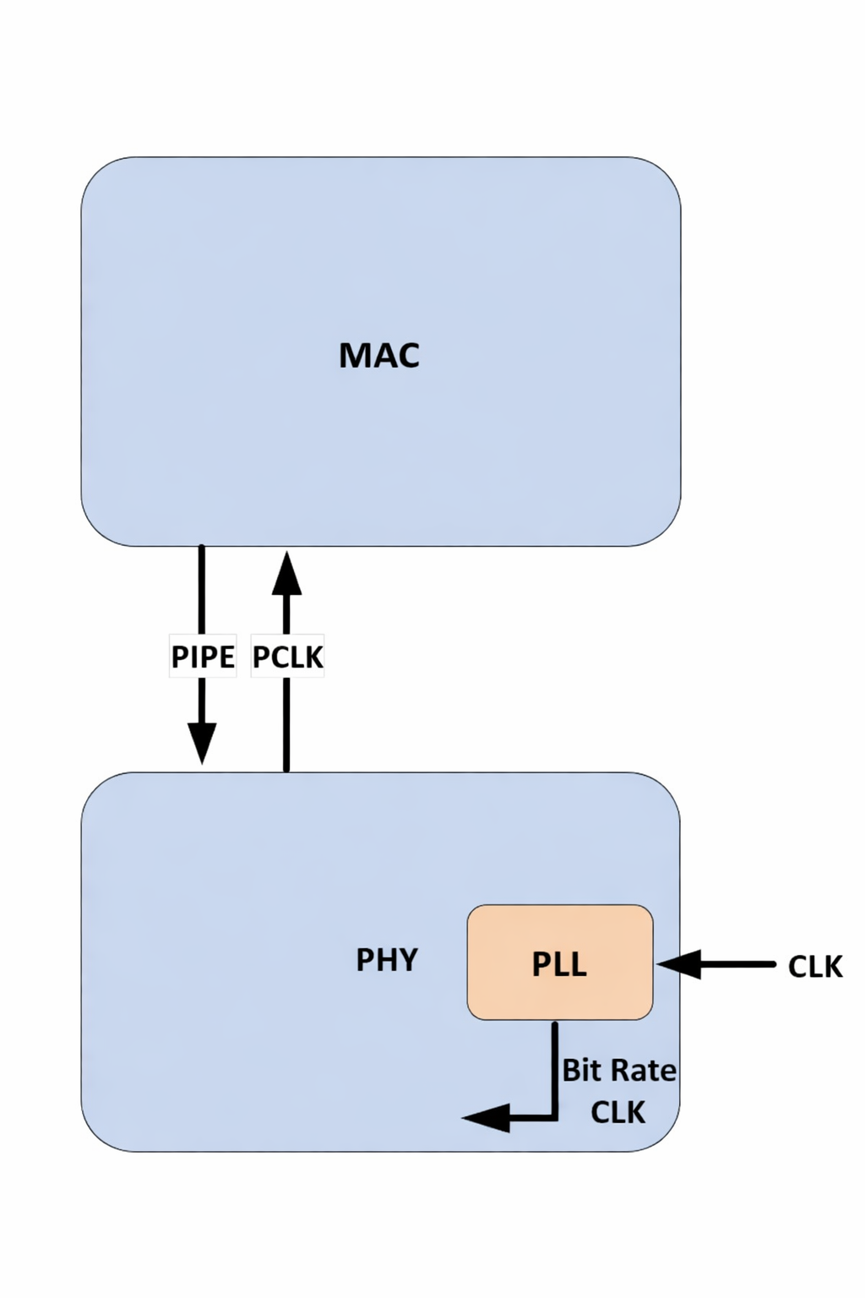
PIPE Operational Behavior
Clocking Topologies
This section describes some clocking topologies that are compatible with PIPE.
This Figure shows PCLK as a PHY output.
This topology is only applicable for legacy
PIPE implementations and is not supported
For PCIe Gen5 designs, USB4 or DisplayPort.

Slide 36
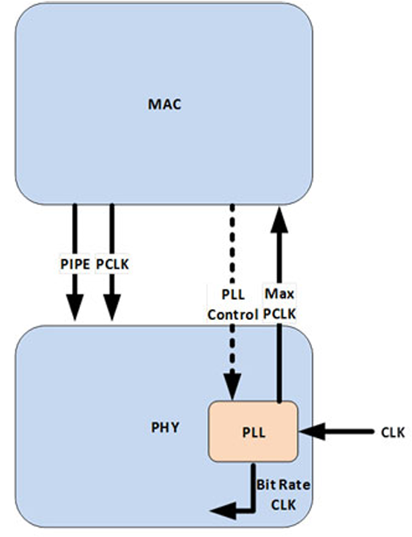
PIPE Operational Behavior
This figure shows PCLK as a PHY input with the PLL residing in the PHY;
The PHY provides a source for PCLK, in this case, MAX PCLK, that is mesochronous to the PHY’s bit rate clock.

Slide 37
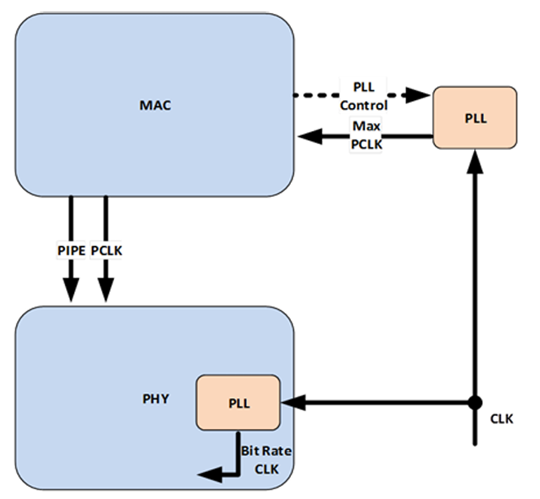
PIPE Operational Behavior
This Figure shows PCLK as a PHY input with the PLL that provides the PCLK source residing outside of the PHY;
The reference clock for PLL that sources the bit rate clock and the PLL that provides the PCLK source must be the same.

Slide 38
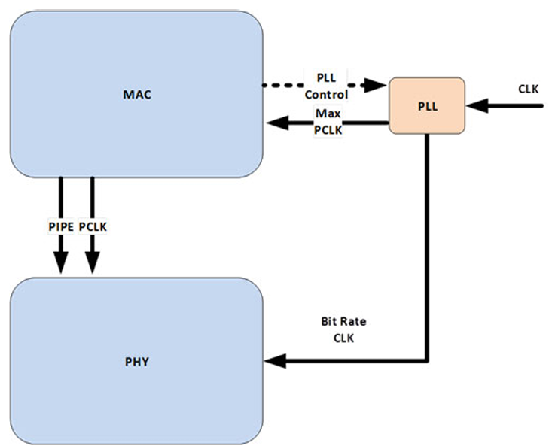
PIPE Operational Behavior
This Figure shows CLK as a PHY input with a single PLL that provides the source for PCLK as well as for the bit rate clock.

Slide 39
PIPE Operational Behavior
MacCLK Clocking Scheme :
  The MacCLK is an optional clock that is independent of data lanes.
  MacCLK frequency is controlled via a MacCLK lane.
  Each MacCLK lane consists of the following signals:
  MacCLKReset#,
  MacCLK,
  MacCLKReq,
  MacCLKSSCEnable,
  MacCLKAck,
  MacCLKPHYMode,
  MacCLKRate.

Slide 40
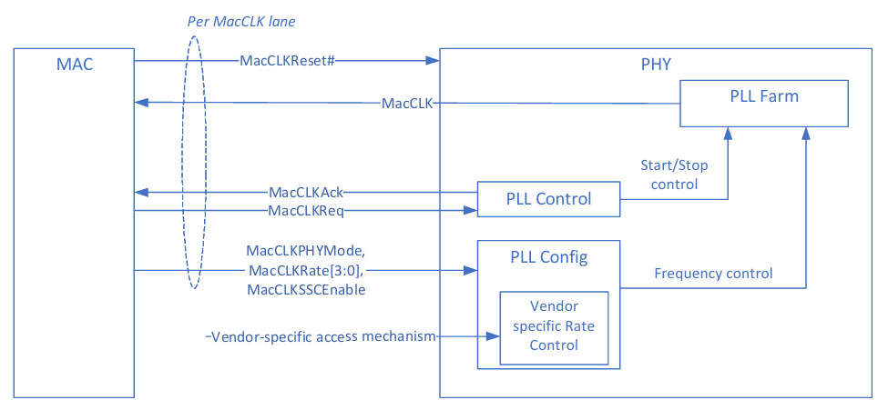
PIPE Operational Behavior
MacCLK Lane :

Slide 41
PIPE Operational Behavior
The following rules apply to each MacCLK lane:
  MacCLKPHYMode, MacCLKRate, MacCLKSSCEnable, MacCLKReq, MacCLKAck must be at a valid value at MacCLKReset# deassertion.
  MacCLKPHYMode must not change after MacCLKReset# deassertion.
  Once MacCLK is running, it must remain stable until MacCLKReq is deasserted.
  Signals that affect MacCLK frequency are sampled only on the rising edge of MacCLKReq.
  MacCLKRate is permitted to change only when MacCLKReq and MacCLKAck are deasserted.
  MACCLKSSCEnable is permitted to be dynamically asserted or deasserted while MacCLK is running. The PHY specifies the maximum time it takes to complete a SSC enable or disable via the MaxSSCEnableDisableTime parameter.
  MacCLKRate defines an override encoding that indicates that a vendor specific mechanism of specifying MacCLK frequency is used.

Slide 42
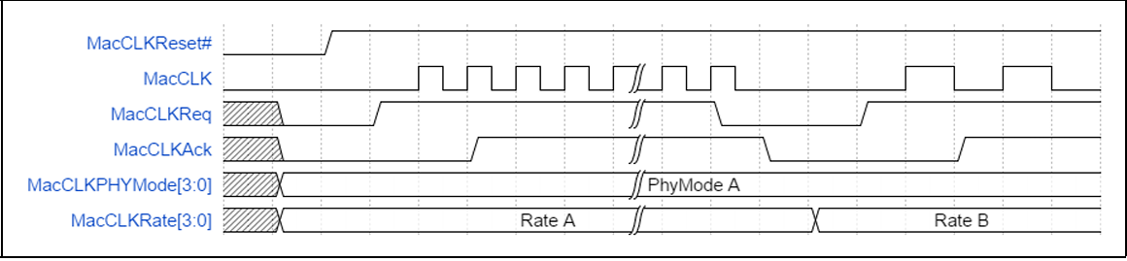
PIPE Operational Behavior
Basic MacCLK Lane Operation
  In this example, MacCLk is requested at an initial rate; subsequently,
  MacCLKReq and MacCLKAck deassert before a a new rate is requested.

Slide 43
PIPE Operational Behavior
Power Management – PCIe Mode
  The Power management signals allow the PHY to reduce power consumption.
  The PHY must meet all PCIe timing requirements for clock recovery and link training in all power states.
  The PHY must satisfy all transmitter and receiver termination requirements.
  Four standard power states are defined: P0, P0s, P1, and P2
  P0 is the normal operating state of the PHY
  When moving from P0 to a lower power state, the PHY can immediately apply power-saving actions
  The PHY may support additional PHY-specific power states (required for L1 substate support)
  The MAC can use these PHY-specific states as long as PCIe specification requirements are met

Slide 44
PIPE Operational Behavior
  In P0, P0s, and P1 states, PCLK must remain active
  For transitions between P0, P0s, P1, or any PHY-specific state where PCLK is active:
    The PHY indicates a successful transition by asserting PhyStatus for one clock cycle
  Transitions into or out of P2 (or PHY-specific states where PCLK is not active) are handled separately
  For all power state transitions, the MAC:
    Must wait for PhyStatus
    Must not start operations or request another transition until the current one is complete

Slide 45
PIPE Operational Behavior
PHY Power States and LTSSM Mapping
  PHY power states are mapped to corresponding LTSSM states defined in the PCIe base specification
  This mapping ensures correct link behavior and compliance
  The MAC may use PHY-specific power states
  PHY-specific states are allowed as long as PCIe base specification requirements are met
  P0 Power State (PHY)
    P0 is the normal operating state of the PHY
    In P0, all internal clocks are active
    PCIe transmit and receive signaling occurs only in P0
    P0 is used for most LTSSM states.

Slide 46
PIPE Operational Behavior
P0s Power State (PHY)
  PCLK remains operational in P0s state
  The MAC can move the PHY to P0s only when the transmit channel is idle
  P0s is typically used when the transmitter is in Tx_L0s.Idle state
  While in P0 or P0s, if the receiver detects electrical idle, it may apply power-saving measures
  When data transmission resumes on the receive channel, the PHY must quickly lock to the signal
  The PHY must achieve bit lock and symbol lock within the specified time (N_FTS)
    Applies with or without a common clock
  This requirement applies only if the receiver was already locked earlier
    That is, the receiver was previously in P0 or P0s state

Slide 47
PIPE Operational Behavior
P1 Power State (PHY)
  In P1 state, some internal PHY clocks can be turned off to save power
  PCLK must remain operational
  The MAC moves the PHY to P1 only when both TX and RX are idle
  The PHY signals successful entry into P1 by asserting PhyStatus only after:
    PCLK is stable
    DC common-mode voltage is stable and within specification
  P1 state is used for LTSSM states:
    Disabled
    Detect states
    L1.Idle (only if L1 substates are not supported)

Slide 48
PIPE Operational Behavior
P2 Power State (PHY)
  P2 is a deep low-power state
  Some internal PHY clocks are turned off
  PCLK is turned OFF
  The parallel interface operates in asynchronous mode
  P2 state is used for LTSSM states:
    L1.Idle
    L2.Idle
    L2.TransmitWake

Slide 49
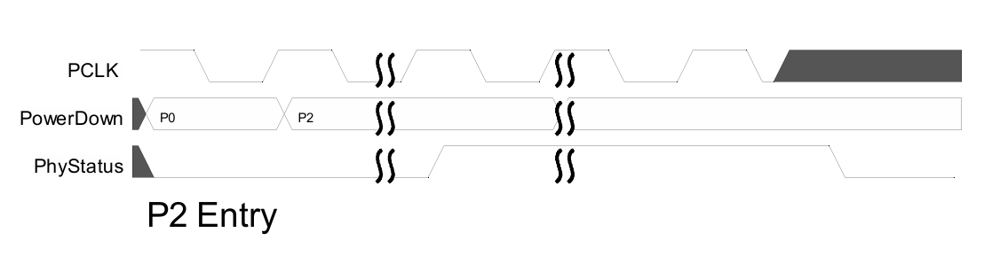
PIPE Operational Behavior
PCIe P2 Entry and Exit with PCLK as PHY Output
  Entering P2 state:
    PHY asserts PhyStatus before PCLK is turned OFF
    PHY then deasserts PhyStatus once PCLK is fully OFF
    This indicates the PHY has successfully entered P2

Slide 50
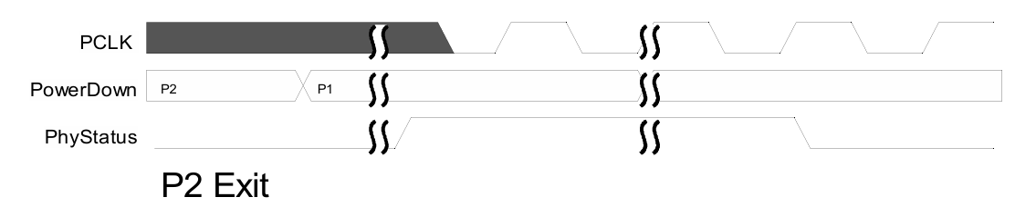
PIPE Operational Behavior
PCIe P2 Entry and Exit with PCLK as PHY Output
  Exiting P2 state:
    PHY asserts PhyStatus as soon as possible
    PhyStatus remains asserted until PCLK becomes stable
    This indicates the PHY is ready to resume operation

Slide 51
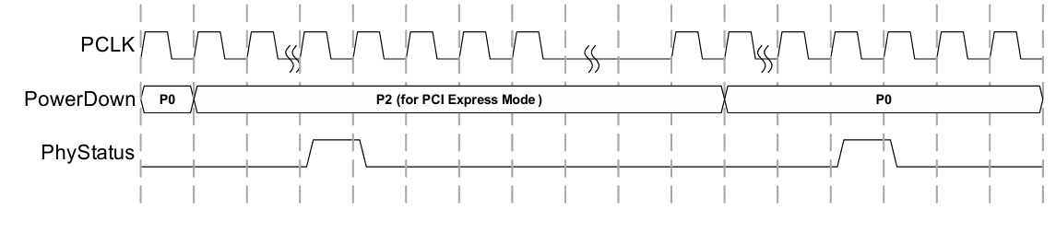
PIPE Operational Behavior
PCIe P2 Entry and Exit with PCLK as PHY Input
  Entering P2 state:
    PHY asserts PhyStatus for one PCLK cycle
    This indicates the PHY is ready for PCLK to be removed
  Exiting P2 state:
    PHY asserts PhyStatus for one PCLK cycle as soon as possible
    This occurs after the PHY transitions back to P0
    Indicates the PHY is ready for normal operation

Slide 52
PIPE Operational Behavior
Transitions Without PCLK & P2 Power Behavior
  When transitioning between two power states where PCLK is not available:
    The PHY asserts PhyStatus once the transition is complete
    PhyStatus remains asserted until the MAC asserts AsyncPowerChangeAck
    After receiving AsyncPowerChangeAck, the PHY deasserts PhyStatus
  In P2 state, the PHY should be designed to minimize power consumption
  This is important because, in P2, the device operates under VAUX power limits defined by the PCIe specification

Slide 53
PIPE Operational Behavior
Legal PHY Power State Transitions
  The MAC is allowed to request only specific power state transitions:
    P0 → P0s
    P0 → P1
    P0 → P2
    P0s → P0
    P1 → P0
    P2 → P0
  The PCIe base specification defines what events cause these transitions.
  Transitions involving PHY-specific power states are also allowed by PIPE
  The MAC must ensure that all PCIe timing requirements are met during any transition

Slide 54
PIPE Operational Behavior
L1 SubState Entry and Exit with PCLK as PHY Output
  L1 SubState Entry
    MAC requests low-power state (P2 / P2-like)
    PHY asserts PhyStatus before shutting down clocks
    PCLK is turned OFF
    REFCLK may be removed
    PHY enters L1 / L1.1 / L1.2 (L1.Idle)
  L1 SubState Exit
    PHY starts wake-up from P2 / P2-like state
    PCLK is restored
    PHY asserts PhyStatus as soon as possible
    PhyStatus remains asserted until PCLK is stable
    MAC acknowledges using AsyncPowerChangeAck
    PHY returns to P1 / P0 and normal operation resumes

Slide 55
PIPE Operational Behavior
Transmitter Margining – PCIe Mode and USB Mode
  While the PHY is in P0 (normal operation), the transmit voltage level can be adjusted
  The MAC changes the voltage using TxMargin[2:0]
  After the change, the PHY must:
    Apply the new transmit voltage
    Start transmitting with the new setting within 128 ns
  Only a limited set of valid TxMargin[2:0] and Rate combinations is allowed
  The MAC must select only supported combinations
  PCIe mode:
    Legal settings are defined in the PCIe base specification

Slide 56
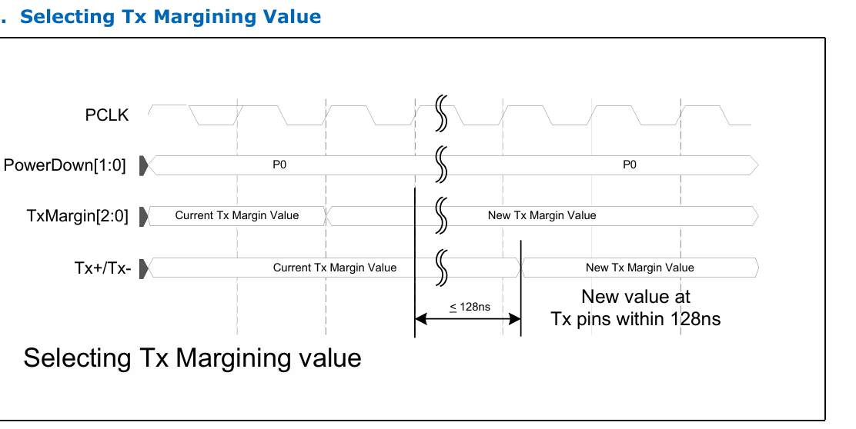
PIPE Operational Behavior
Transmitter Margining – PCIe Mode and USB Mode

Slide 57
PIPE Operational Behavior
Selectable De-Emphasis – PCIe Mode
TX Equalization (TxDeemph) Change – P0 State
  In P0 power state, the PHY supports transmitter equalization changes
  Supported signaling rates:
    5.0, 8.0, 16, 32, 64, and 128 GT/s
  The MAC updates transmitter equalization using TxDeemph
PHY Update Time Requirement
  At 5.0 GT/s:
    PHY must apply the new TxDeemph value within 128 ns
  At 8.0 GT/s and higher (16/32/64/128 GT/s):
    PHY must apply the new TxDeemph value within 256 ns

Slide 58
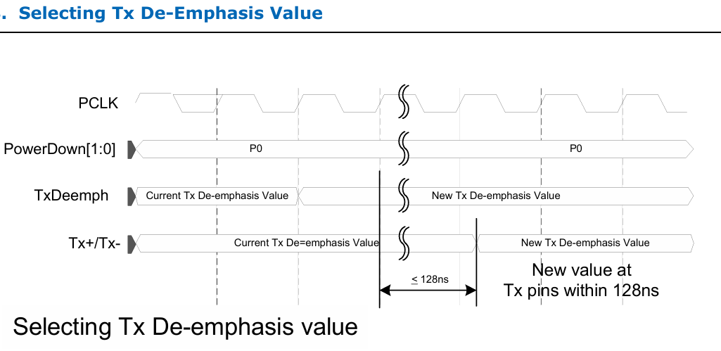
PIPE Operational Behavior
TxDeemph and Rate Rules
  Only a limited set of valid TxDeemph and Rate combinations is allowed
  The MAC must select only supported combinations
  Detailed legal combinations are defined in the PCIe base specification
  When Rate = 2.5 GT/s, the MAC must set TxDeemph to –3.5 dB

Slide 59
PIPE Operational Behavior
Receiver Detection – PCIe Mode
  Receiver detection is allowed in P1 (optionally P2) power state
  Receiver Detection Process
    MAC initiates detection by asserting:
      TxDetectRx/Loopback
    PHY performs the receiver detect sequence
    On completion:
      PHY asserts PhyStatus for one clock
      PHY drives RxStatus with the detection result
  MAC must hold TxDetectRx/Loopback until PHY completes detection, especially in deep power states like P2 or P3.

Slide 60
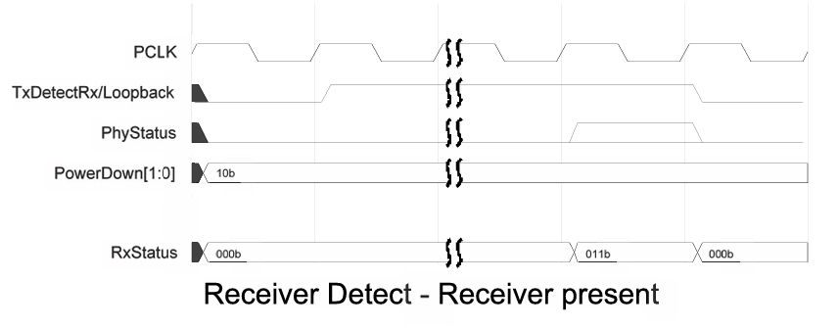
PIPE Operational Behavior
Receiver Detection – PCIe Mode
Detected Condition | RxStatus Code
Receiver not present | 000b
Receiver present | 011b

Slide 61
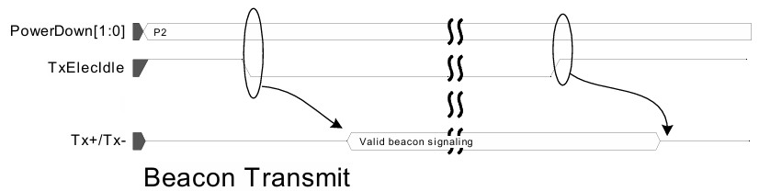
PIPE Operational Behavior
Transmitting a Beacon – PCIe Mode
  When the PHY is in P2 state, and the MAC wants to transmit a beacon:
    MAC deasserts TxElecIdle
    PHY generates a valid beacon signal
  The PHY continues transmitting the beacon:
    Until TxElecIdle is asserted again
  Before transitioning PHY from P2 → P0:
    MAC must assert TxElecIdle
  A beacon is a low-power wake-up signal
  transmitted by the PHY to indicate link
  presence during deep power states.

Slide 62
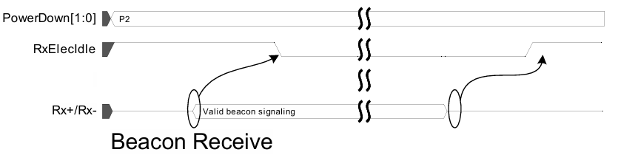
PIPE Operational Behavior
Detecting a Beacon – PCIe Mode
  The PHY receiver must continuously monitor for electrical idle
    Except during reset
    Or when RxEIDetectDisable is set
  When the PHY is in P2 power state:
    If RxElecIdle is deasserted
    It indicates that a beacon is detected

Slide 63
PIPE Operational Behavior
Error Detection – PCIe Mode
  The PHY detects different types of receive errors
  Errors are reported to the MAC using:
    RxStatus[2:0] signals
  Due to higher-layer error checking (e.g., CRC in Data Link layer):
    Exact symbol identification is not required
    But correct timing of the error is important
  Error Signaling Method
  When a receive error occurs:
    PHY asserts the appropriate error code
    For one clock cycle
    At the point in the parallel data stream closest to the error location

Slide 64
PIPE Operational Behavior
Error Priority (Highest to Lowest)
  If multiple errors occur in the same data unit, report in this priority order:
  8B/10B decode error or Block decode error
  Elastic buffer overflow
  Elastic buffer underflow (Cannot occur in Nominal Empty buffer model)
  Disparity error
  Misalign error (SATA mode only)
Header Error Handling
  The PHY does NOT detect:
    128/130B header errors (PCIe)
  The PHY passes raw header bits to the controller
  The controller (MAC/Data Link layer) is responsible for:
    Header error detection
    Error handling

Slide 65
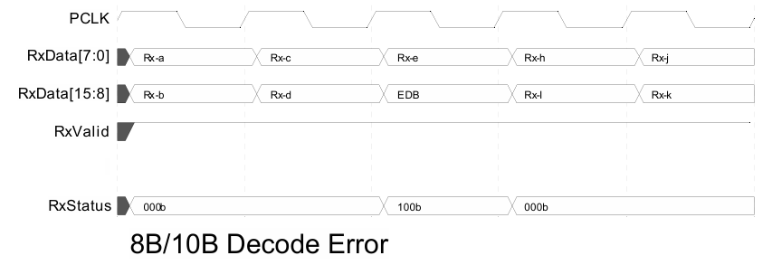
PIPE Operational Behavior
8B/10B Decode Errors
  If PHY detects an 8B/10B decode error:
  Replace bad byte with:
    End Bad [EDB (PCIe / SATA)]
  PHY sets RxStatus = Decode Error
  Error is indicated for one clock cycle
Important Rule
  If both decode error and disparity error occur:
    Decode error has higher priority

Slide 66
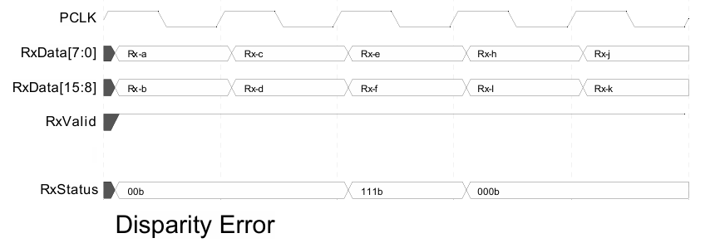
PIPE Operational Behavior
Disparity Errors
  If PHY detects a disparity error:
    It asserts RxStatus = Disparity Error
    Error is indicated during the clock cycle of the affected byte
  In wider interfaces (16/32/64-bit):
    It may not be possible to know which exact byte had the error
Important Notes
  PHY may optionally signal disparity error as:
    8B/10B decode error (0b100)
  Many MACs treat:
    Decode errors and disparity
    errors the same

Slide 67
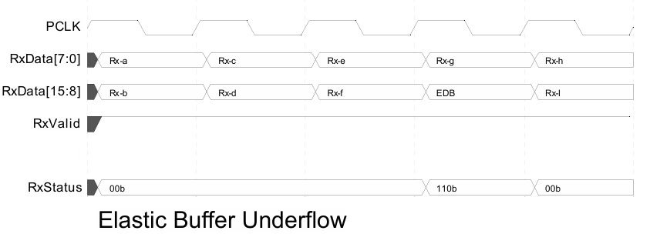
PIPE Operational Behavior
                Elastic Buffer Errors
Elastic Buffer Underflow Error
  If elastic buffer underflow occurs:
    PHY inserts: EDB (PCIe / SATA)
  The inserted symbol appears in the data stream
  During that clock cycle:
    PHY sets RxStatus = Buffer Underflow

Slide 68
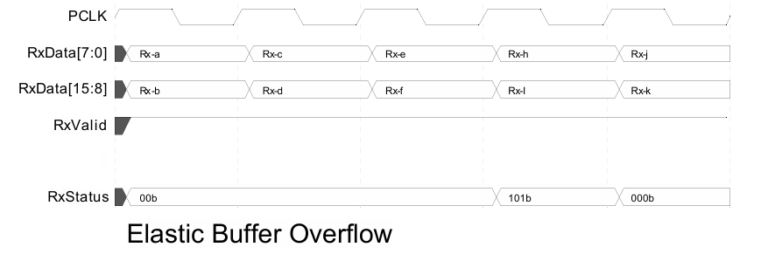
PIPE Operational Behavior
                Elastic Buffer Errors
Elastic Buffer Overflow Error
  If elastic buffer overflow occurs:
    One or more symbols are dropped
  PHY signals the overflow:
    During the clock cycle when the dropped symbol would have appeared
    By setting RxStatus = Buffer Overflow

Slide 69


